Slide 1

stay & learn
YEAR 1

Slide 2
What is phonics?
A method of teaching beginners to read and pronounce words by learning to associate letters or letter groups with the sounds they represent.
There are 44 main sounds in the English Language. Each sound is represented by a grapheme (the written representation of a sound).

Slide 3
Key vocabulary
Phoneme: the smallest single identifiable sound in a word.
For example, in the word 'cat' there are three phonemes c/a/t.
Grapheme: the written representation of a sound.
Digraph: two letters making one sound. For example, /sh/ in the word 'shop'.
Trigraph: three letters making one sound. For example, /igh/ in the word 'night'.
Split digraph: two vowel letters split but are split by one or more consonants. For example, /a-e/ in the word 'cake'.

Slide 4
ELS – Essential letters and sounds
Essential Letters and Sounds (ELS) is our chosen phonics programme
Children will experience the joy of books and language whilst rapidly acquiring the skills they need to become fluent independent readers and writers.

Slide 5
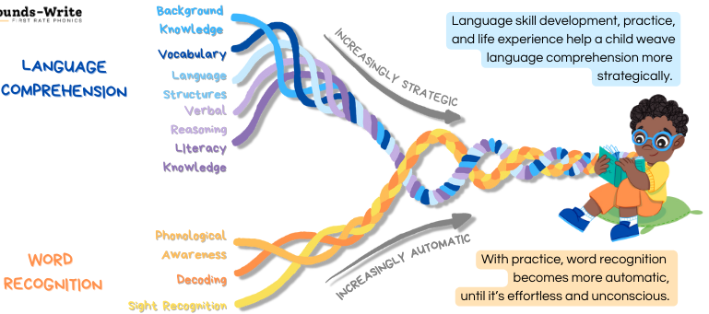

Slide 6
Phonics Screening Check
Phonics Screening Check is a statutory assessment conducted in the Summer Term of Year One.
Introduced in 2011, to ensure that all children have learnt phonic decoding to an age-appropriate standard.
The aim of the PSC was to encourage all schools to pursue a rigorous phonics programme for all children from the start of primary school.

Slide 7
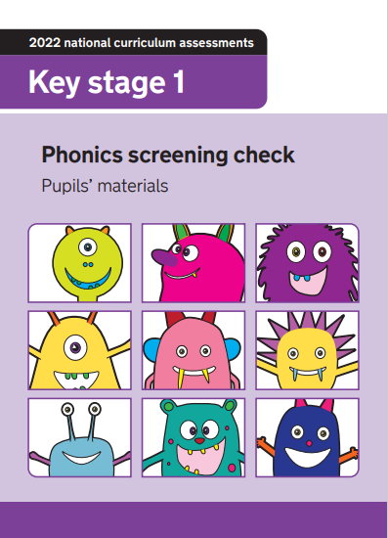
What does the psc assess?
40 words
Section 1: 8 real words and 12 pseudo words
Section 2: 12 real words and 8 pseudo words

Slide 8
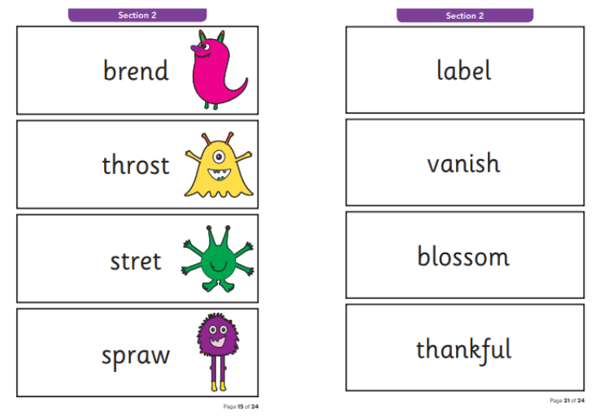
Key Information
Pseudo words, are not real words. In the
assessment, these words will have an alien image next to them.
All accents will be taken into account when the child is answering.
Any pronunciation difficulties will be taken into account.
Your child’s final answer is what we will take.
Children who have not met the standard in Year 1 will re-take the screening check in Year 2.

Slide 9
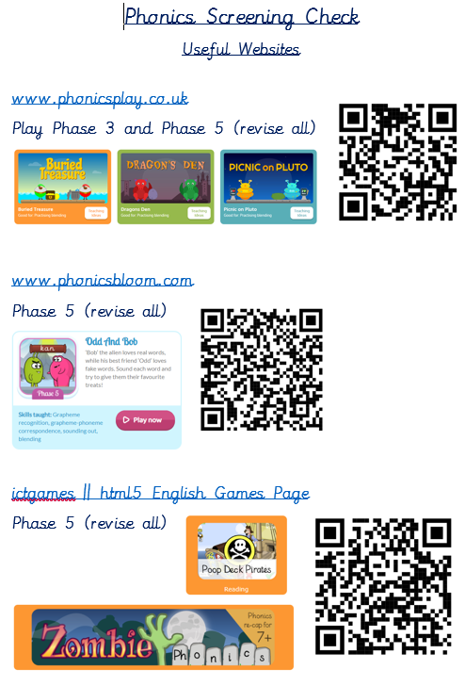
How can you Help at home?
Read children’s decodable books. Children are reading from books which are entirely decodable. We only use pure sounds when decoding words (no ‘uh’ after the sound)
We want them to practise reading their book five times across the week working on these skills:
- decoding
- fluency
- expression

Slide 10
ANY QUESTIONS?

