Slide 1
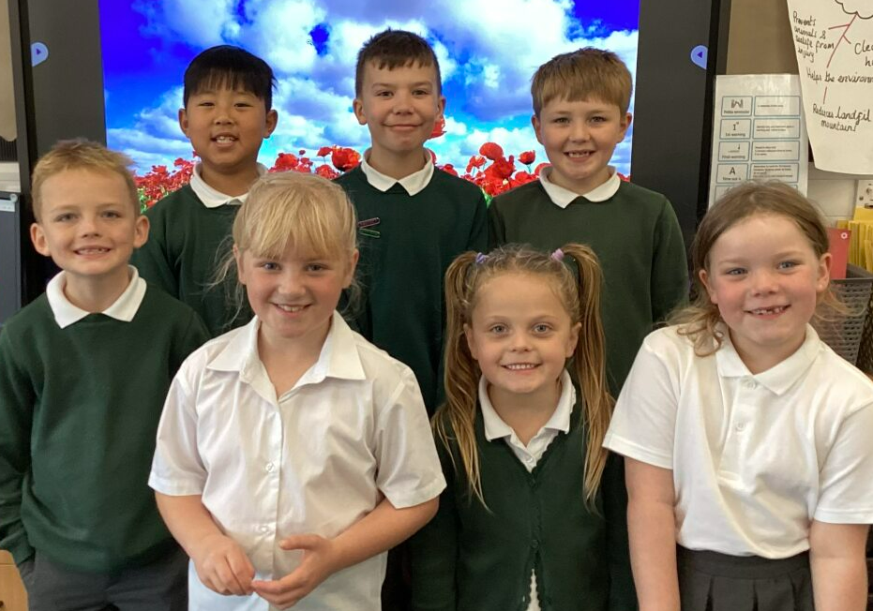
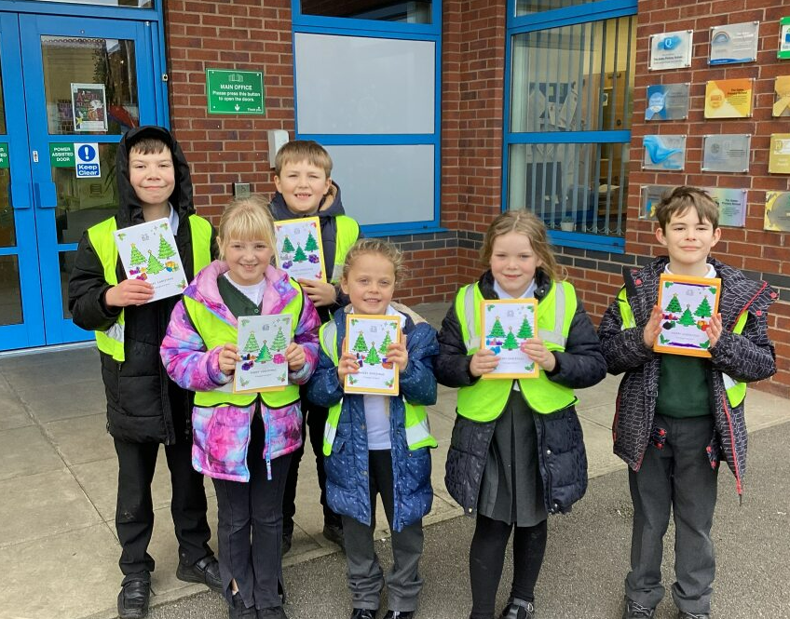
Our School Council update
Spring Term

Slide 2
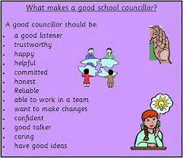
Our first meeting!

Slide 3
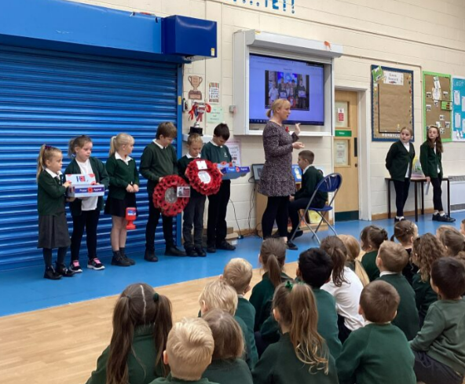
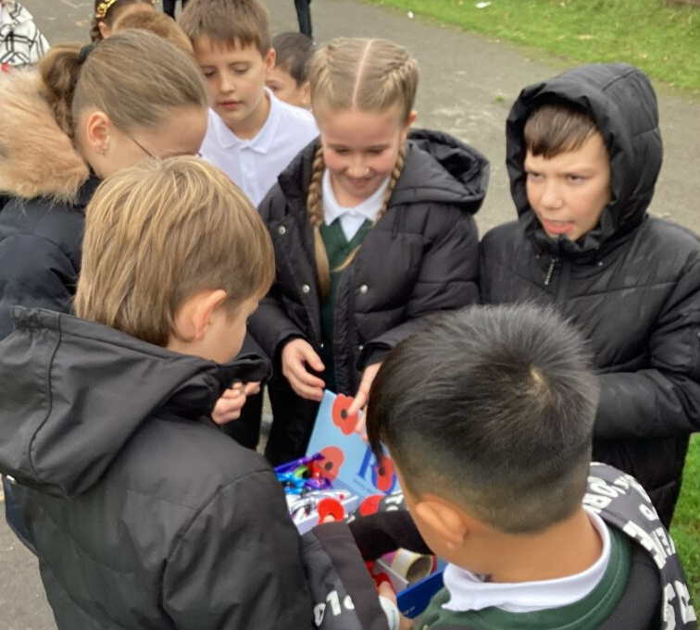
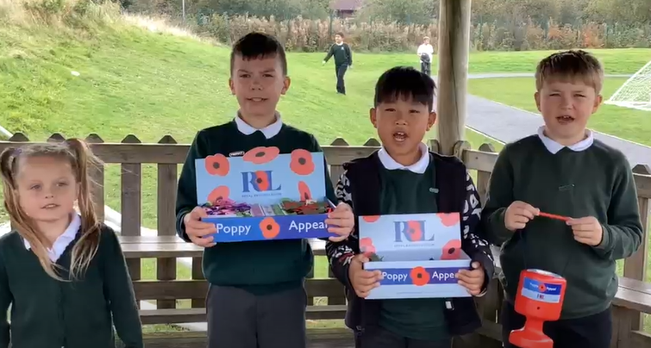
Poppies
We raised £174.67

Slide 4
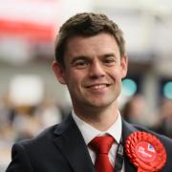
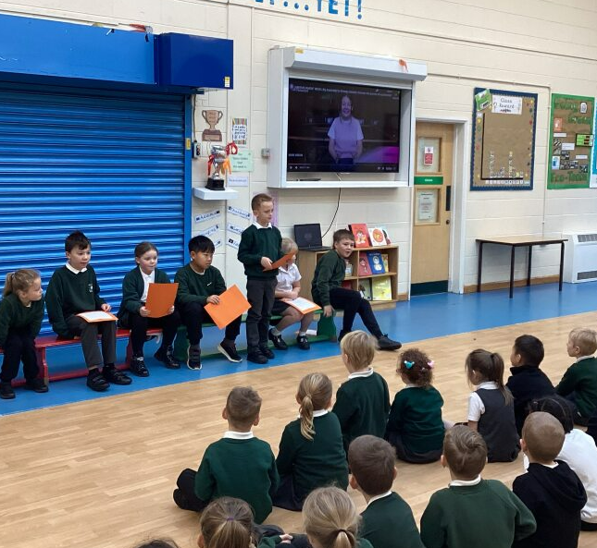
Parliament Week

Slide 5
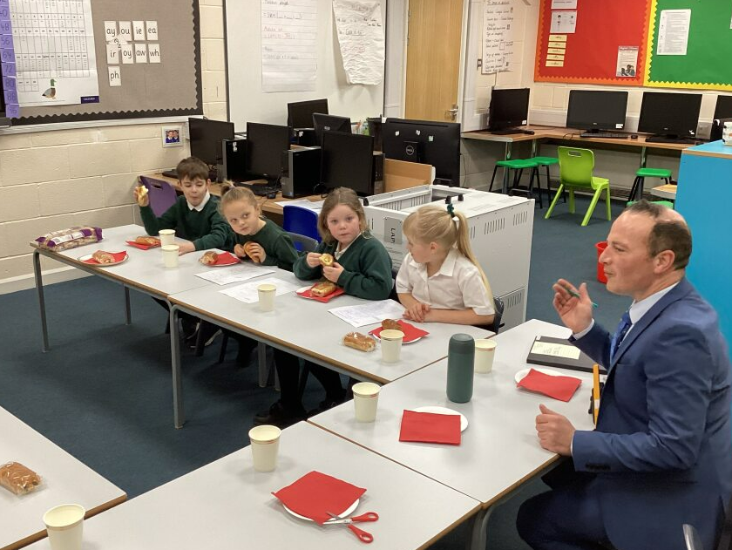
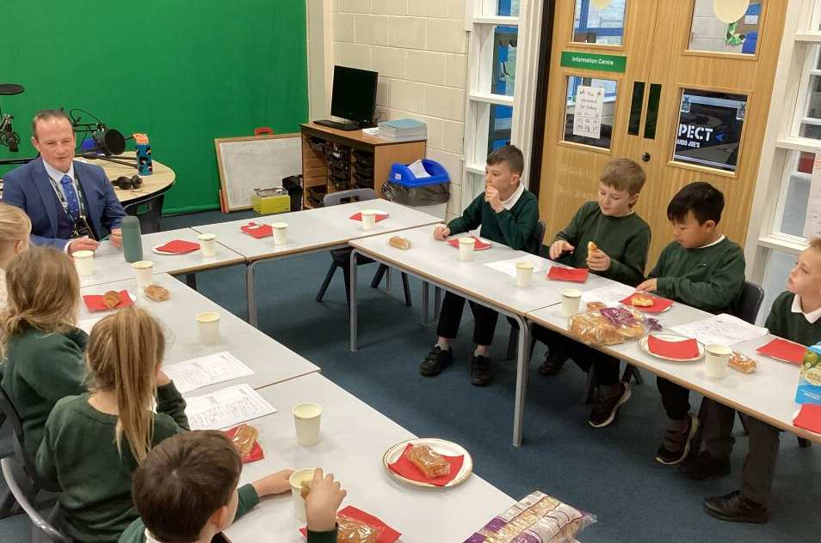
Our breakfast meetings

Slide 6
Our breakfast meetings Before the meetings we ask our classes what is important to them. We share these ideas with Mr Doherty

Slide 7
Our breakfast meetings We shared with Mr Doherty about how we wanted play leaders. We asked him if we could paint the other pavilion We talked about ‘Break the Rules’ day

Slide 8
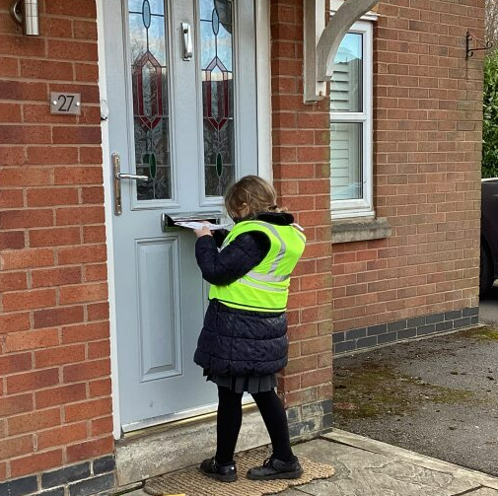
Christmas Cheer!

Slide 9
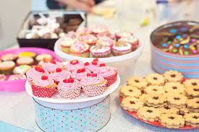
Our next steps!

